Slide 1


CDO Vault and Databricks
Or
“How to store data and run Python in a secure environment”
Dr Bruce Cox, Dr. Paul Auclair & Dr. Torrey Wagner

Slide 2
Outline
Part 1 (slides 3-11)
Requesting a VAULT account
Requesting access to the Databricks python environment
Part 2 (slides 12-29)
Importing an existing .ipynb file
Importing a data file
Integration & addressing common problems

Slide 3



Motivation
You can now (or will be able to) perform numerous data analysis techniques using Python, and likely used Python on your home computer or a web service like Google Colaboratory
However, these environments can’t process CUI, PII or classified data
A natural question is “How does this help me at work?”
This is where the CDO (Chief Data Officer) Vault swoops in to save the day
Chief Data Officer – Real Picture

Slide 4
Request Access
On a NIPR computer (or VDI into a .mil network):
Navigate to: https://afdatalab.af.mil
Select DOD ID certificate to authenticate
Create a new account
When the new account is created, use the Help Desk tile to request access to the “AFAC” tenant.
The User Interface (UI) tends to change (improve) over time, but the basic steps remain the same.

Slide 5
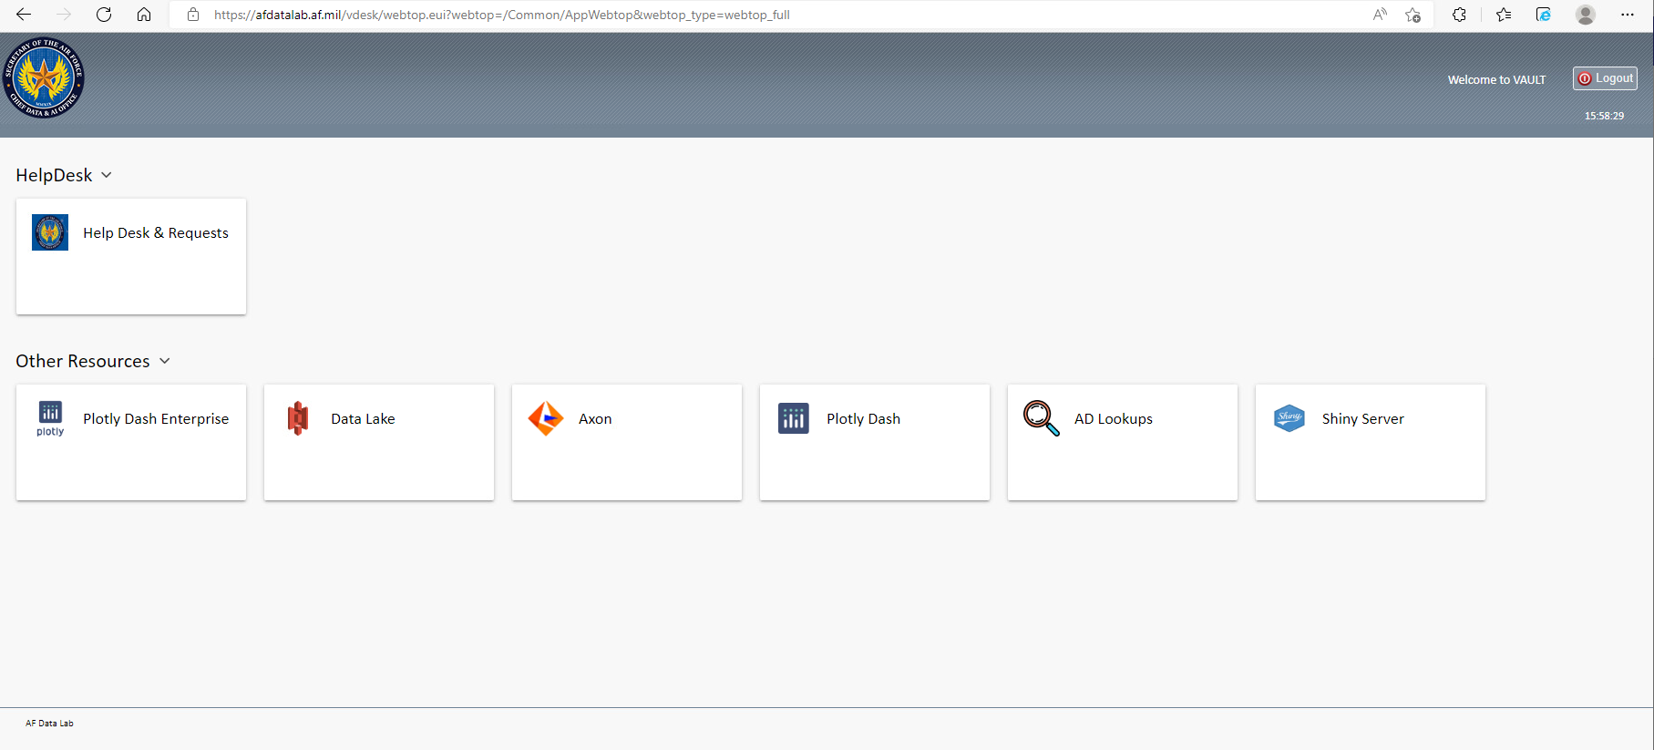
Request Access
When you log on for the first time, your screen will look like this.
Click on “Help Desk & Requests”

Slide 6
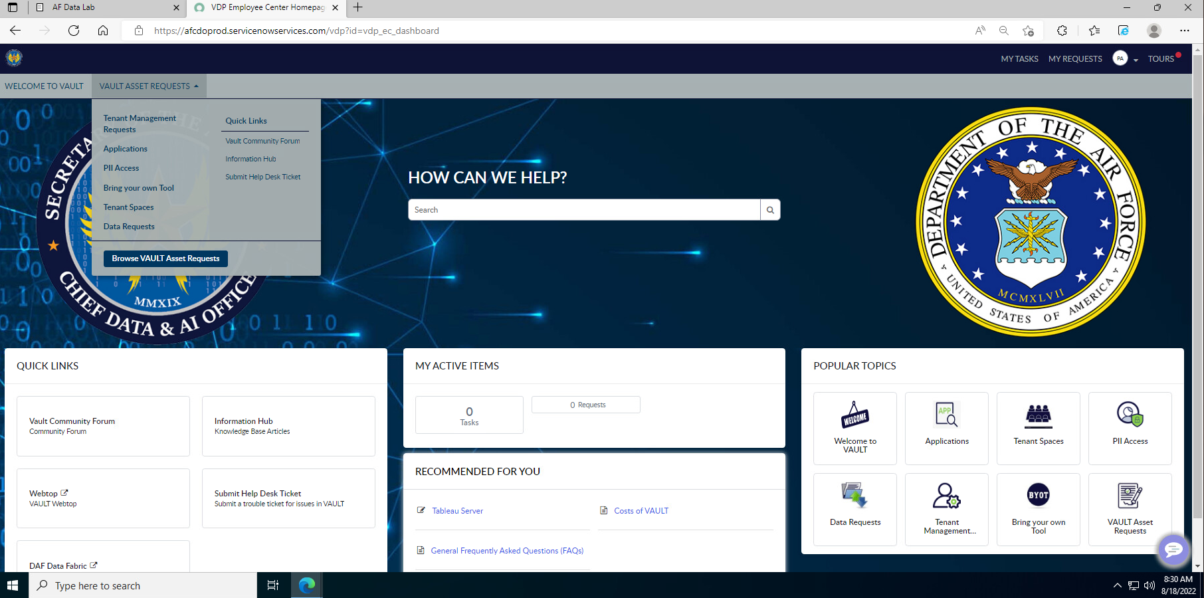
Request Access
Select “Browse Access Requests”
from the
VAULT ASSET Requests pulldown menu

Slide 7
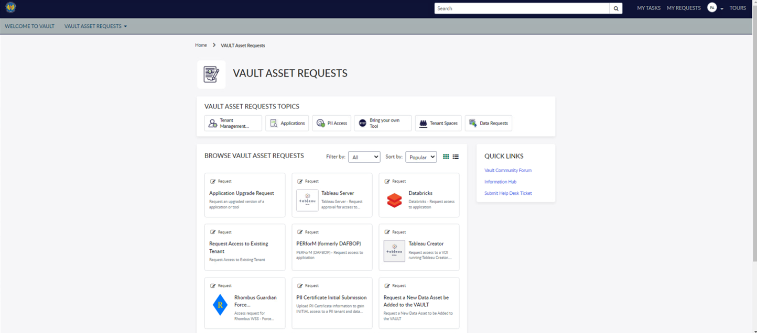
Request Access
You’ll make two
requests from
this page
First request access
to applications hosted on an existing tenant.

Slide 8
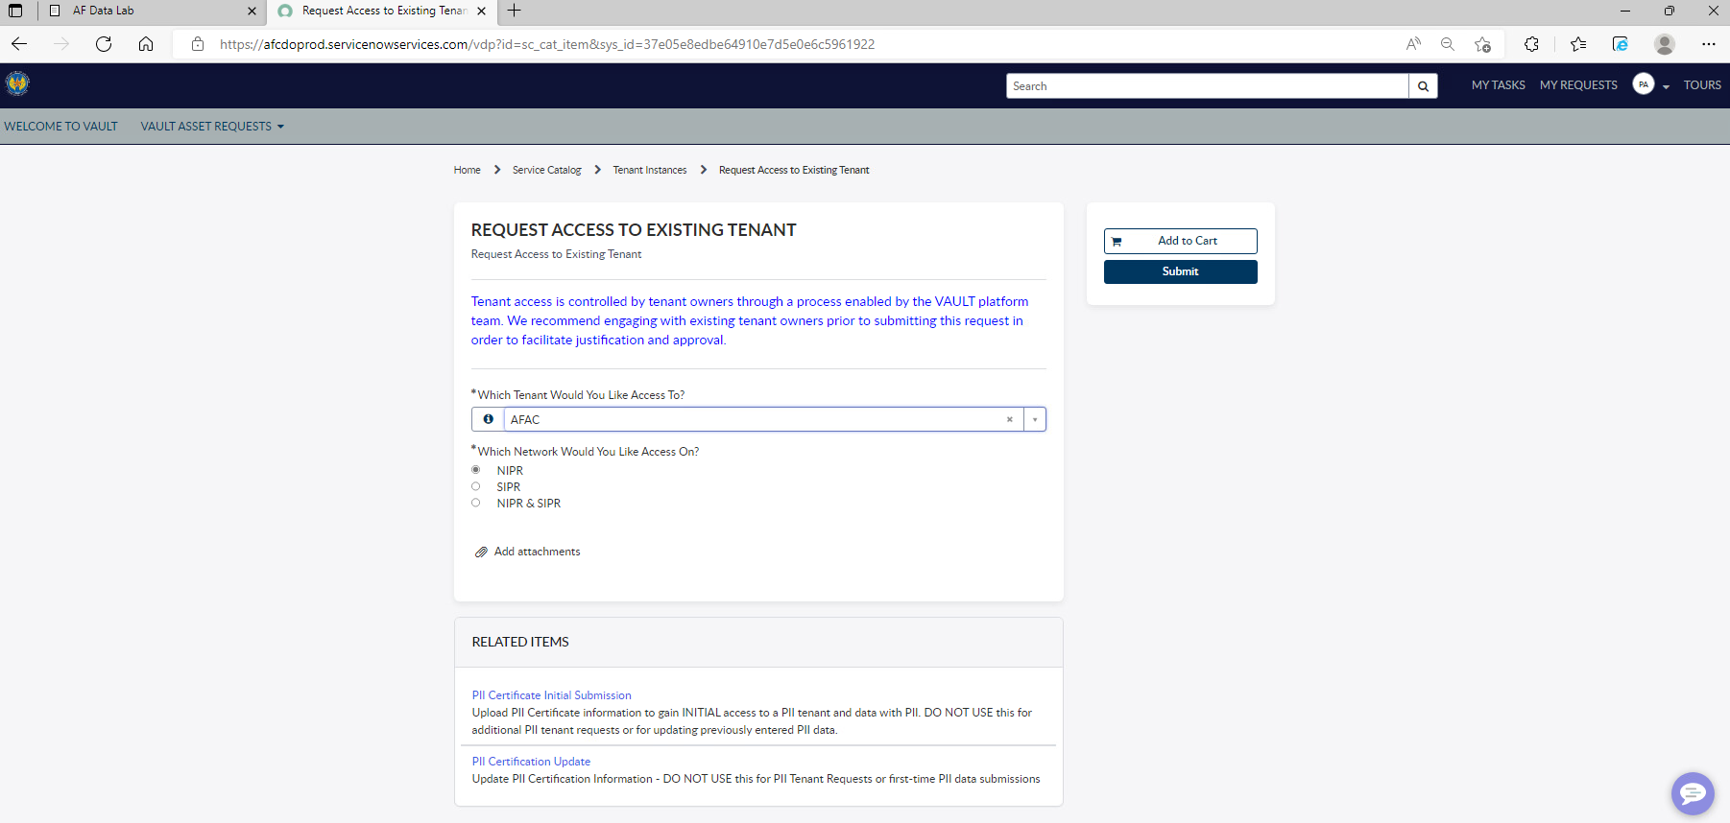
Request Access
2. Add to Cart
and Submit.
1. Select the AFAC tenant and desired networks.
3. Wait. It could be up to a
day before you get Databricks added to your account.
There is no cost to you or
your organization.

Slide 9
Request Access
Return to this page
and request access
to Databricks.

Slide 10
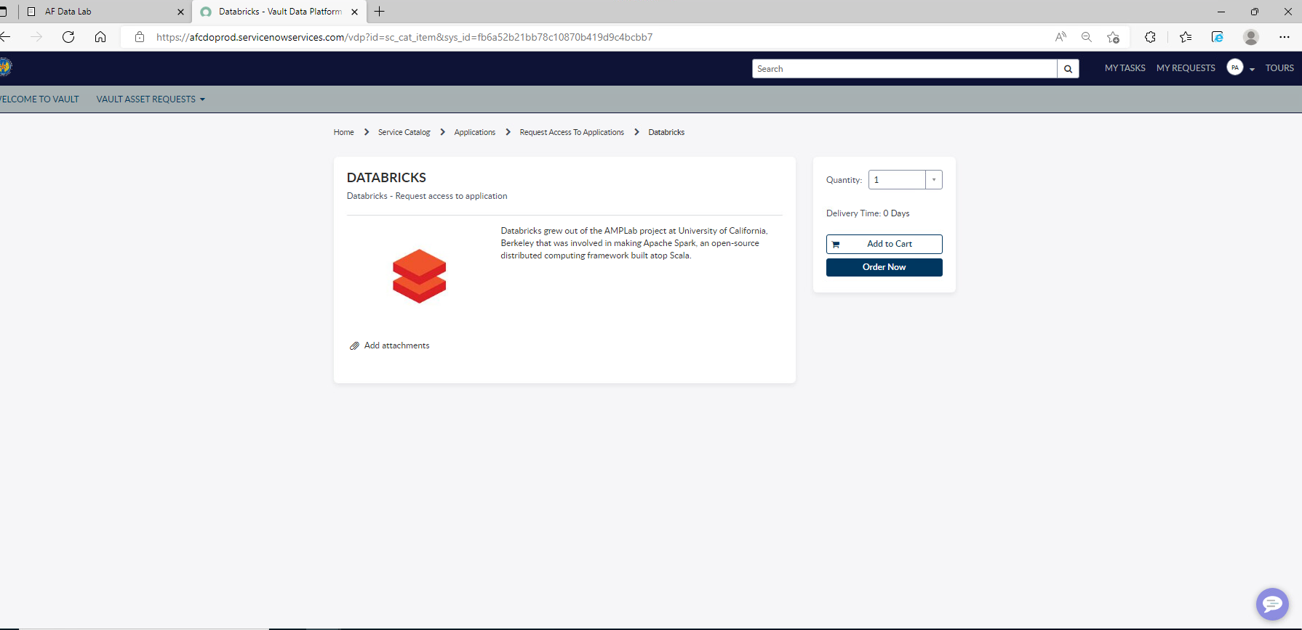
Request Access
Add to Cart and Order now.
Wait. It could be up to a day before you get Databricks added to your account.
There is no cost to you or your organization.

Slide 11
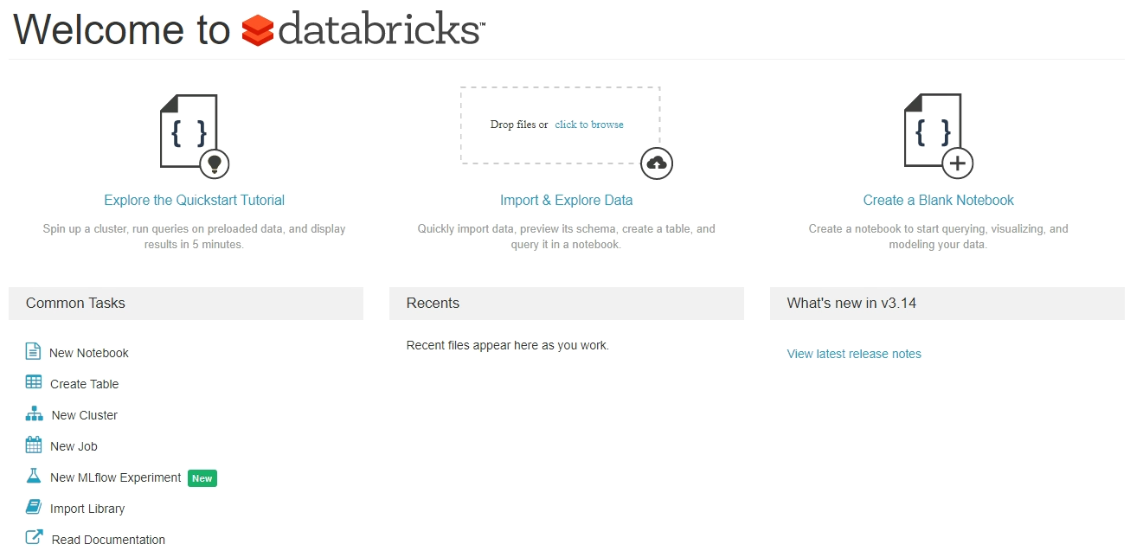
Databricks Home
Once Databricks is added to your account you will see a Databricks Tile on your home screen. Click it and you end up here.

Slide 12
Part 2
Importing an existing .ipynb file,
Importing a data file,
Integration of datafile
Addressing common problems

Slide 13
Importing an existing .ipynb file,
Importing a data file,
Integration of datafile
Addressing common problems

Slide 14
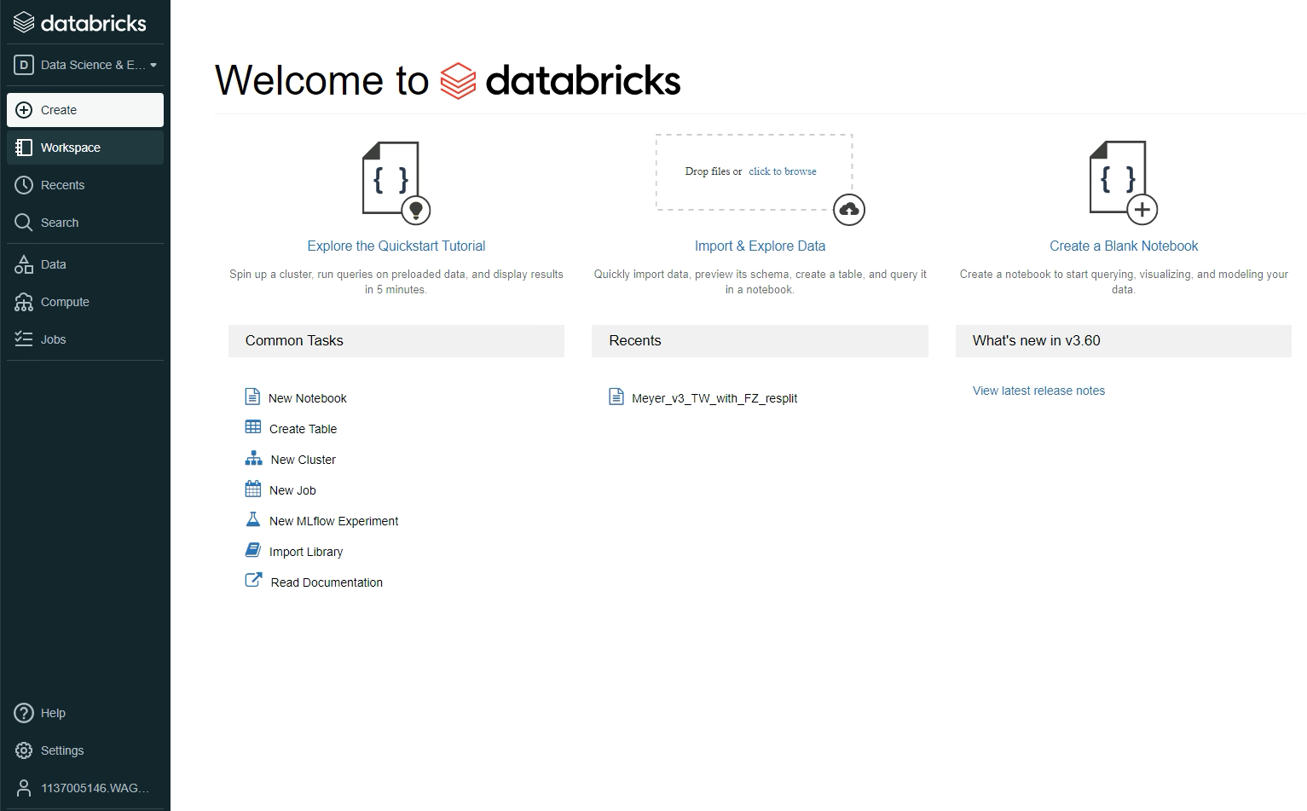
Import a .ipynb file
Log into VAULT
Click on Databricks
Click on Workspace (left side)
Note your username (bottom left)

Slide 15
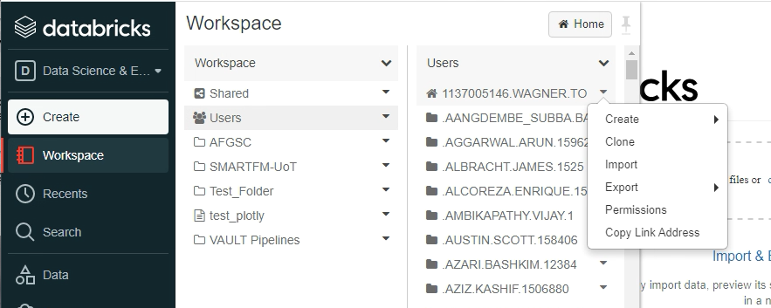
Import a .ipynb file
Click on Workspace
Click Users
Find your folder (should be on top and match your username on last slide)
Click the dropdown arrow by your folder
Click Import

Slide 16
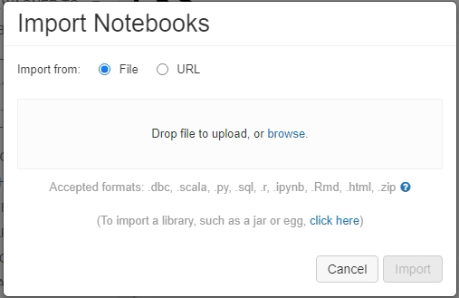
Import a .ipynb file
Drag your .ipynb file onto the dialog box, click Import

Slide 17
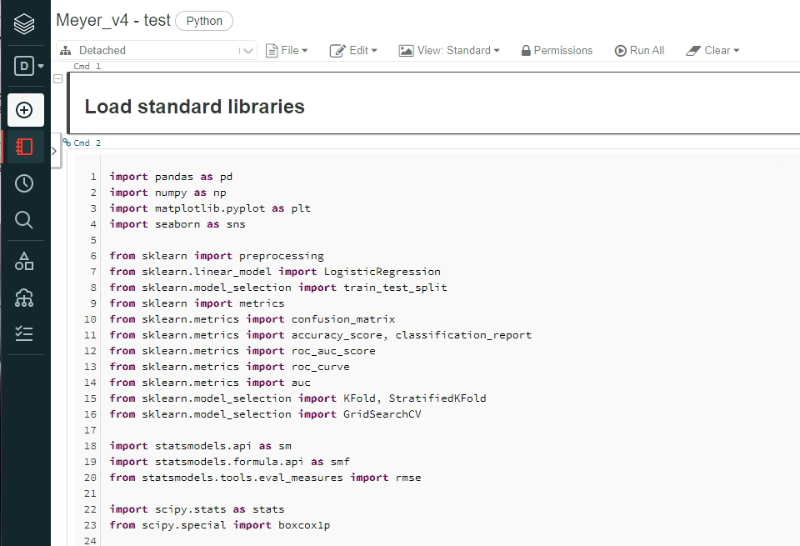
Import a .ipynb file
The file should be displayed
Make a shortcut to this webpage to easily get back to your file
You’ll have to log into VAULT & Databricks before clicking on the shortcut

Slide 18
Importing an existing .ipynb file,
Importing a data file,
Integration of datafile
Addressing common problems

Slide 19
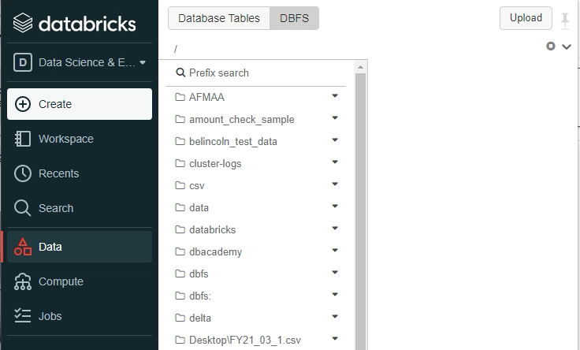
Import a datafile
Click Data
Click DBFS
Click Upload

Slide 20
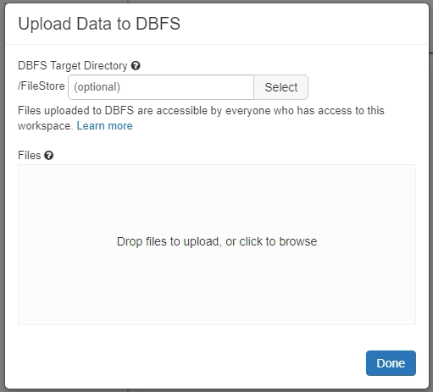
Import a datafile
Drag your datafile onto the dialog box, click Import

Slide 21
Importing an existing .ipynb file,
Importing a data file,
Integration of datafile
Addressing common problems

Slide 22
Integration of Datafile
Get the link
Go back to your file
Paste into your code
1st, we’ll get the link

Slide 23
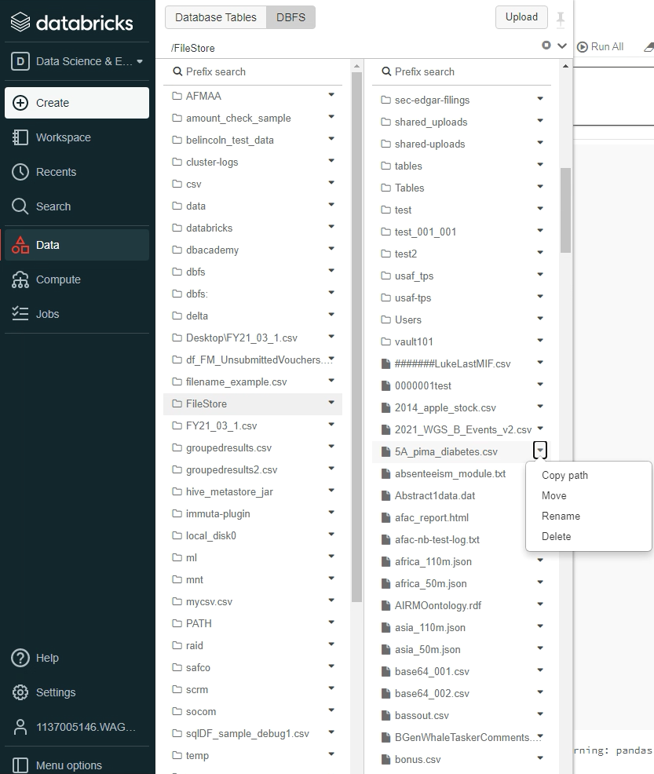
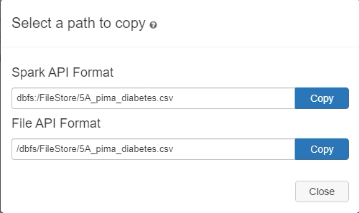
Click Data
Click DBFS
Click FileStore
Click the dropdown next to your filename, and Copy Path
Click Copy, near File API Format
below

Slide 24
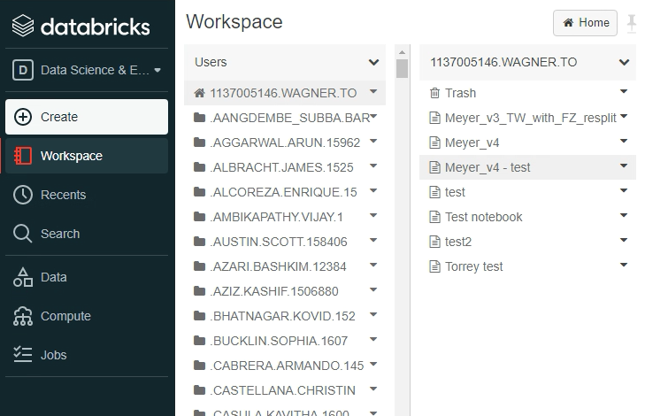
Integration of Datafile
Get the link
Go back to your file
Paste into your code
Either click the shortcut you made, or
Click Workspace
Click your folder
Double click your python file

Slide 25
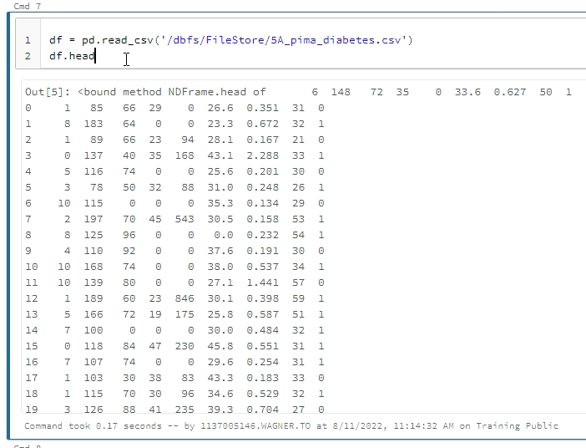
Integration of Datafile
Get the link
Go back to your file
Paste into your code

Slide 26
Importing an existing .ipynb file,
Importing a data file,
Integration of datafile
Addressing common problems

Slide 27
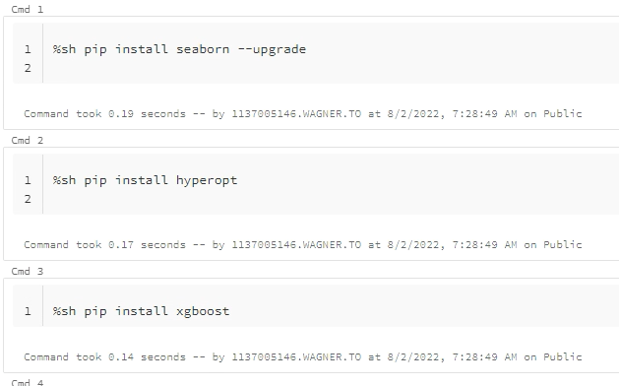
Add libraries as needed
Add one per block
If pip install doesn’t work use shell command prefix %sh

Slide 28

Some libraries won’t work
If you get errors, check the version number of the library you are using
Colab uses seaborn 0.11.2, databricks has version 0.10.0. I had to upgrade the library to prevent an error
Some version variation was OK for me
Colab python 3.7.13, databricks 3.7.5
Colab XGBoost 0.90, databricks 1.6.1
Some won’t work regardless of your efforts - Ax-client hyperparameter sweep tool is an example
Research an alternative
Preferably, one that people say works on Databricks – Hyperopt worked for me

Slide 29
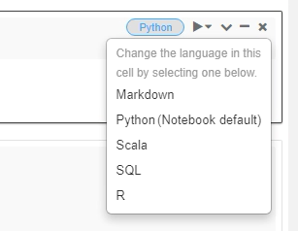
A few quirks
Sometimes Databricks will take several minutes to execute the 1st block
When getting dataframe information in Databricks, sometimes there are formatting errors:
Error: df.info() OK: df.info
Error: df.dtypes() OK: df.dtypes
New blocks will always be code blocks. To change from a code block to a text header, click Python and then Markdown

